Slide 1
Data and Computer Communications
Chapter 21 – Multiprotocol Label Switching
Ninth Edition
by William Stallings
Notes:
“Data and Computer Communications”, 9/e, by William Stallings, Chapter 21 “Multiprotocol Label Switching”.

Slide 2
Multiprotocol Label Switching
"No ticket! Dear me, Watson, this is really very singular. According to my experience it is not possible to reach the platform of a Metropolitan train without exhibiting one's ticket.”
—The Adventure of the Bruce-Partington Plans
Sir Arthur Conan Doyle
Notes:
This quote is from the start of Stallings DCC9e Chapter 21.

Slide 3
Multiprotocol Label Switching (MPLS)
MPLS is a set of IETF specifications for including routing and traffic engineering information in packets
comprises a number of interrelated protocols - - MPLS protocol suite
is used to ensure that all packets in a particular flow take the same route over a backbone
deployed by many telecommunication companies and service providers
delivers QoS required to support real-time voice and video and SLAs that guarantee bandwidth
Notes:
In Chapter 19, we examined a number of IP-based mechanisms designed to improve the performance of IP-based networks and to provide different levels of quality of service (QoS) to different service users. Although the routing protocols discussed in Chapter 19 have as their fundamental purpose dynamically finding a route through an internet between any source and any destination, they also provide support for performance goals in two ways:
1. Because these protocols are distributed and dynamic, they can react to congestion by altering routes to avoid pockets of heavy traffic. This tends to smooth out and balance the load on the internet, improving overall performance.
2. Routes can be based on various metrics, such as hop count and delay. Thus a routing algorithm develops information that can be used in determining how to handle packets with different service needs.
More directly, some of the mechanisms Chapter 19 (IS, DS) provide enhancements to an IP-based internet that explicitly provide support for QoS. However, none of the mechanisms or protocols so far discussed in Chapter 19 directly addresses the performance issue: how to improve the overall throughput and delay characteristics of an internet. MPLS is intended to provide connection-oriented QoS with features similar to those found in Differentiated Services; support traffic management to improve network throughput: and retain the flexibility of an IP-based networking approach.
Multiprotocol label switching (MPLS) is a set of Internet Engineering Task Force (IETF) specifications for including routing and traffic engineering information in packets. Thus, MPLS comprises a number of interrelated protocols, which can be referred to as the MPLS protocol suite. It can be used in IP networks but also in other types of packet-switching networks. MPLS is used to ensure that all packets in a particular flow take the same route over a backbone. Deployed by many telecommunication companies and service providers, MPLS delivers the quality of service (QoS) required to support real-time voice and video as well as service level agreements (SLAs) that guarantee bandwidth.
We begin this chapter with an overview of the current status of MPLS as a networking technology.
Although the basic principles of MPLS are straightforward, the set of protocols and procedures that have been built up around MPLS is formidable. As of this writing, the IETF MPLS working group has issued 70 RFCs and has 29 active Internet Drafts. In addition, there four other IETF working groups developing RFCs on topics related to MPLS. Thus, even a book-length treatment fails to capture the full extent of MPLS. Accordingly, the goal is this chapter is to present the fundamental concepts and an overview of the breadth of MPLS.

Slide 4
Role of MPLS
efficient technique for forwarding and routing packets
designed with IP networks in mind
can be used with any link-level protocol
fixed-length label encapsulates an IP packet or a data link frame
MPLS label contains all information needed to perform routing, delivery, Qos, and traffic management functions
is connection oriented
Notes:
In essence, MPLS is an efficient technique for forwarding and routing packets. MPLS was designed with IP networks in mind, but the technology can be used without IP to construct a network with any link-level protocol, including ATM and frame relay. In an ordinary packet-switching network packet switches must examine various fields within the packet heard to determine destination, route, quality of service (QoS), and any traffic management functions (such as discard or delay) that may be supported. Similarly, in an IP-based network, routers examine a number of fields in the IP header to determine these functions. In an MPLS network, a fixed-length label encapsulates an IP packet or a data link frame. The MPLS label contains all the information needed by an MPLS-enabled router to perform routing, delivery, QoS, and traffic management functions. Unlike IP, MPLS is connection oriented.

Slide 5
MPLS Growth
Internet Engineering Task Force (IETF) is the lead organization in developing MPLS-related specifications and standards
deployed in almost every major IP network
reasons MPLS is accepted:
embraced IP
built-in flexibility
protocol neutral
adapts existing protocols
is adaptable
supports metrics
scales
Notes:
The IETF MPLS working group is the lead organization in developing MPLS-related specifications and standards. A number other working groups deal with MPLS-related issues. Briefly, the objectives of these groups are:
MPLS: Responsible for standardizing a base technology for using label switching and for the implementation of label-switched paths over various packet based link-level technologies, such as Packet-over-SONET, Frame Relay, ATM, and LAN technologies (e.g. all forms of Ethernet, Token Ring, etc.). This includes procedures and protocols for the distribution of labels between routers and encapsulation.
Common Control and Measurement Plane (CCAMP): responsible for defining a common control plane and a separate common measurement plane for physical path and core tunneling technologies of Internet and telecom service providers (ISPs and SPs), e.g. O-O and O-E-O optical switches, TDM Switches, Ethernet Switches, ATM and Frame Relay switches, IP encapsulation tunneling technologies, and MPLS.
Layer 2 Virtual Private Networks (l2vpn): Responsible for defining and specifying a limited number of solutions for supporting provider-provisioned Layer-2 Virtual Private Networks (L2VPNs). The objective is to support link layer interfaces, such as ATM and Ethernet, for providing VPNs for an MPLS-enabled IP packet switched network.
Layer 3 Virtual Private Networks (l3vpn): Responsible for defining and specifying a limited number of solutions for supporting provider-provisioned Layer-3 (routed) Virtual Private Networks (L3VPNs). Standardization includes supporting VPNs for end systems that have an IP interface over an MPLS-enabled IP packet switched network.
Pseudowire Emulation Edge to Edge (pwe3): Responsible for specifying protocols for pseudowire emulation over an MPLS network. A pseudowire emulates a point-to-point or point-to-multipoint link, and provides a single service that is perceived by its user as an unshared link or circuit of the chosen service.
Path Computation Element (PCE): Focuses on the architecture and techniques for constraint-based path computation.
The magnitude of this effort suggests the importance, indeed the coming dominance, of MPLS. A 2009 survey found that 84% of companies are now using MPLS for their wide area networks [REED09]. MPLS is deployed in almost every major IP network. [MARS09] lists the following reasons for the dramatic growth in MPLS acceptance.
1. MPLS embraced IP. In the early 1990s, the telecom industry was pinning their hopes on ATM as the network backbone technology of the future, and made substantial investment. But as Internet usage exploded, carriers needed to refocus their efforts. At the same time, IETF was looking for ways to make circuit-oriented ATM technology run over IP. The result was the MPLS effort, which was quickly adopted by ATM proponents.
2. MPLS has built-in flexibility in several ways. MPLS separates out a control component, which enables various applications to directly manipulate label bindings, and a forwarding component, which uses a simple label-swapping paradigm. Also, MPLS allows labels to be stacked, enabling multiple control planes to act on a packet.
3. MPLS is protocol neutral. MPLS is designed to work in a multiple protocol environment. This enables MPLS to work with ATM, frame relay, SONET, or Ethernet at the core.
4. MPLS is pragmatic. The architecture created only two new protocols: Label Distribution Protocol and Link Management Protocol. Everything else incorporates or adapts existing protocols.
5. MPLS is adaptable. MPLS has evolved over time to support new applications and services, including layer 2 and layer 3 virtual private networks (VPNs), Ethernet services, and traffic engineering.
6. MPLS supports metrics. MPLS allows carriers to collect a wide variety of statistics that can be used for network traffic trend analysis and planning. With MPLS, it’s possible to measure traffic volume, latency and delay between two routers. Carriers also can measure traffic between hubs, metropolitan areas, and regions.
7. MPLS scales. For example, Verizon uses MPLS for several global networks including its public and private IP networks. Verizon’s Public IP network spans 410 points of presence on six continents and spans more than 150 countries.
It is clear that MPLS will permeate virtually all areas of networking. Hence the need for students to gain a basic understanding of its technology and protocols.

Slide 6
Background of MPLS
IP switching (Ipsilon)
tag switching (Cisco Systems)
aggregate route-based IP switching (IBM)
Cascade (IP navigator)
IETF set up the MPLS working group (1997)
first set of proposed standards (2001)
key specification is RFC 3031
Notes:
The roots of MPLS go back to a number of efforts in the mid-1990s to provide a comprehensive set of QoS and traffic engineering capabilities in IP-based networks. The first such effort to reach the marketplace was IP switching, developed by Ipsilon. To compete with this offering, numerous other companies announced their own products, notably Cisco Systems (tag switching), IBM (aggregate route-based IP switching), and Cascade (IP navigator). The goal of all these products was to improve the throughput and delay performance of IP, and all took the same basic approach: Use a standard routing protocol such as OSPF to define paths between endpoints and assign packets to these paths as they enter the network.
In response to these proprietary initiatives, the IETF set up the MPLS working group in 1997 to develop a common, standardized approach. The working group issued its first set of Proposed Standards in 2001. The key specification is RFC 3031. MPLS reduces the amount of per-packet processing required at each router in an IP-based network, enhancing router performance even more. More significantly, MPLS provides significant new capabilities in four areas that have ensured its popularity: QoS support, traffic engineering, virtual private networks, and multiprotocol support. Before turning to the details of MPLS, we briefly examine each of these.

Slide 7
Connection-Oriented QoS Support
connectionless networks cannot provide firm QoS commitments
has powerful traffic management and QoS capabilities
MPLS imposes framework on an IP-based Internet
provides the foundation for sophisticated and reliable QoS traffic contracts
Notes:
Connection-Oriented QoS Support
Network managers and users require increasingly sophisticated QoS support for a number of reasons. [SIKE00] lists the following key requirements:
Guarantee a fixed amount of capacity for specific applications, such as audio/video conference.
Control latency and jitter and ensure capacity for voice.
Provide very specific, guaranteed, and quantifiable service level agreements, or traffic contracts.
Configure varying degrees of QoS for multiple network customers.
A connectionless network, such as in IP-based internet, cannot provide truly firm QoS commitments. A differentiated service (DS) framework works in only a general way and upon aggregates of traffic from a number of sources. An IS framework, using RSVP, has some of the flavor of a connection-oriented approach but is nevertheless limited in terms of its flexibility and scalability. For services such as voice and video that require a network with high predictability, the DS and IS approaches, by themselves, may prove inadequate on a heavily loaded network. By contrast, a connection-oriented network, as we have seen, has powerful traffic management and QoS capabilities. MPLS imposes a connection-oriented framework on an IP-based internet and thus provides the foundation for sophisticated and reliable QoS traffic contracts.

Slide 8
Traffic Engineering
ability to define routes dynamically, plan resource commitments on the basis of known demand, and optimize network utilization
effective use can substantially increase usable network capacity
ATM provided strong traffic engineering capabilities prior to MPLS
with basic IP there is a primitive form
MPLS:
is aware of flows with QoS requirements
possible to set up routes on the basis of flows
paths can be rerouted intelligently
Notes:
Traffic Engineering
MPLS makes it easy to commit network resources in such a way as to balance the load in the face of a given demand and to commit to differential levels of support to meet various user traffic requirements. The ability to define routes dynamically, plan resource commitments on the basis of known demand, and optimize network utilization is referred to as traffic engineering. Prior to the advent of MPLS, the one networking technology that provided strong traffic engineering capabilities was ATM.
With the basic IP mechanism, there is a primitive form of automated traffic engineering. Specifically, routing protocols such as OSPF enable routers to dynamically change the route to a given destination on a packet-by-packet basis to try to balance load. But such dynamic routing reacts in a very simple manner to congestion and does not provide a way to support QoS. All traffic between two endpoints follows the same route, which may be changed when congestion occurs. MPLS, on the other hand, is aware of not just individual packets but flows of packets in which each flow has certain QoS requirements and a predictable traffic demand. With MPLS, it is possible to set up routes on the basis of these individual flows, with two different flows between the same endpoints perhaps following different routers. Further, when congestion threatens, MPLS paths can be rerouted intelligently. That is, instead of simply changing the route on a packet-by-packet basis, with MPLS, the routes are changed on a flow-by-flow basis, taking advantage of the known traffic demands of each flow. Effective use of traffic engineering can substantially increase usable network capacity.

Slide 9
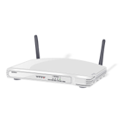
MPLS Support
provides an efficient mechanism for supporting VPNs
can be used on a number of networking technologies
enhancement to the way a connectionless IP-based internet is operated
can coexist with ordinary IP routers
designed to work in ATM and frame relay
Notes:
Virtual Private Network (VPN) Support
MPLS provides an efficient mechanism for supporting VPNs. With a VPN, the traffic of a given enterprise or group passes transparently through an internet in a way that effectively segregates that traffic from other packets on the internet, proving performance guarantees and security.
Multiprotocol Support
MPLS can be used on a number of networking technologies. Our focus in this chapter is on IP-based internets, and this is likely to be the principal area of use. MPLS is an enhancement to the way a connectionless IP-based internet is operated, requiring an upgrade to IP routers to support the MPLS features. MPLS-enabled routers can coexist with ordinary IP routers, facilitating the introduction of evolution to MPLS schemes. MPLS is also designed to work in ATM and frame relay networks. Again, MPLS-enabled ATM switches and MPLS-enabled frame relay switches can be configured to coexist with ordinary switches. Furthermore, MPLS can be used in a pure IP-based internet, a pure ATM network, a pure frame relay network, or an internet that includes two or even all three technologies. This universal nature of MPLS should appeal to users who currently have mixed network technologies and seek ways to optimize resources and expand QoS support.
For the remainder of this discussion, we focus on the use of MPLS in IP-based internets, with brief comments about formatting issues for ATM and frame relay networks.

Slide 10
Key MPLS Terms
Notes:
Stallings DCC9e Table 21.1 defines key MPLS terms used in our discussion.

Slide 11
MPLS Operation
label switching routers (LSRs)
nodes capable of switching and routing packets on the basis of label
labels define a flow of packets between two endpoints
assignment of a particular packet is done when the packet enters the network of MPLS routers
connection-oriented technology
Notes:
An MPLS network or internet consists of a set of nodes, called label switching routers (LSRs) capable of switching and routing packets on the basis of which a label has been appended to each packet. Labels define a flow of packets between two endpoints or, in the case of multicast, between a source endpoint and a multicast group of destination endpoints. For each distinct flow, called a forwarding equivalence class (FEC), a specific path through the network of LSRs is defined, called a label switched path (LSP). In essence, an FEC represents a group of packets that share the same transport requirements. All packets in an FEC receive the same treatment en route to the destination. These packets follow the same path and receive the same QoS treatment at each hop. In contrast to the forwarding in ordinary IP networks, the assignment of a particular packet to a particular FEC is done just once, when the packet enters the network of MPLS routers.
Thus, MPLS is a connection-oriented technology. Associated with each FEC is a traffic characterization that defines the QoS requirements for that flow. The LSRs need not examine or process the IP header but rather simply forward each packet based on its label value. Each LSR builds a table, called a label information base (LIB), to specify how a packet must be treated and forwarded. Thus, the forwarding process is simpler than with an IP router.

Slide 12
Label Assignment
based on:
destination unicast routing
traffic engineering
multicast
virtual private network (VPN)
QoS
Notes:
Label assignment decisions (i.e., the assignment of a packet to a give FEC and hence a given LSP) may be based on the following criteria:
Destination unicast routing: in the absence of other criteria, packets flowing from one source to one destination may be assigned to the same FEC.
Traffic engineering: packet flows may be split up or aggregated to accommodate traffic engineering requirements.
Multicast: multicast routes through the network may be defined.
Virtual private network (VPN): Traffic among end systems for a particular customer may be segregated from other traffic on a public MPLS network by means of a dedicated set of LSPs.
QoS: Traffic may be assigned different FECs for different QoS requirements.

Slide 13
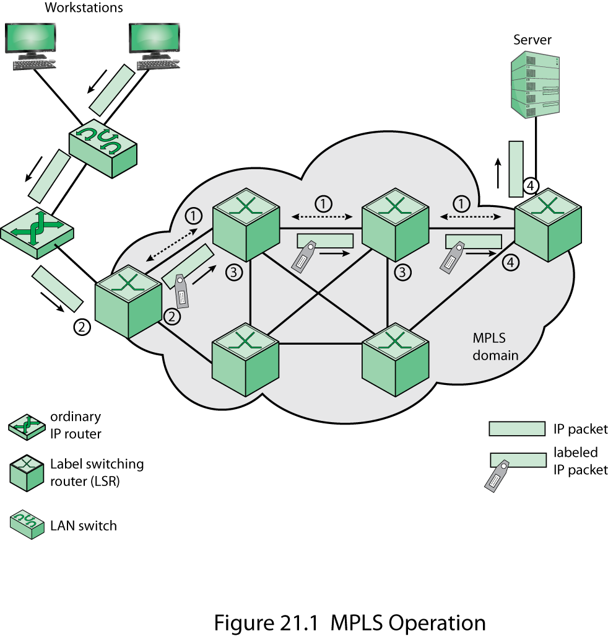
MPLS Operation
Notes:
Stallings DCC9e Figure 21.1 depicts the operation of MPLS within a domain of MPLS-enabled routers. The following are key elements of the operation:
1. Prior to the routing and delivery of packets in a given FEC, a path through the network, known as a label switched path (LSP), must be defined and the QoS parameters along that path must be established. The QoS parameters determine (1) how much resources to commit to the path, and (2) what queuing and discarding policy to establish at each LSR for packets in this FEC. To accomplish these tasks, two protocols are used to exchange the necessary information among routers:
(a) An interior routing protocol, such as OSPF, is used to exchange reachability and routing information.
(b) Labels must be assigned to the packets for a particular FEC. Because the use of globally unique labels would impose a management burden and limit the number of usable labels, labels have local significance only, as discussed subsequently. A network operator can specify explicit routes manually and assign the appropriate label values. Alternatively, a protocol is used to determine the route and establish label values between adjacent LSRs. Either of two protocols can be used for this purpose: the Label Distribution Protocol (LDP) or an enhanced version of RSVP. LDP is now considered the standard technique, with the RSVP approach deprecated.
2. A packet enters an MPLS domain through an ingress edge LSR, where it is processed to determine which network-layer services it requires, defining its QoS. The LSR assigns this packet to a particular FEC, and therefore a particular LSP; appends the appropriate label to the packet; and forwards the packet. If no LSP yet exists for this FEC, the edge LSR must cooperate with the other LSRs in defining a new LSP.
3. Within the MPLS domain, as each LSR receives a labeled packet, it
(a) Removes the incoming label and attaches the appropriate outgoing label to the packet
(b) Forwards the packet to the next LSR along the LSP
4. The egress edge LSR strips the label, reads the IP packet header, and forwards the packet to its final destination.
Several key features of MLSP operation can be noted at this point:
1. An MPLS domain consists of a contiguous, or connected, set of MPLS-enabled routers. Traffic can enter or exit the domain from an endpoint on a directly connected network, as shown in the upper-right corner of Figure 21.1. Traffic may also arrive from an ordinary router that connects to a portion of the internet not using MPLS, as shown in the upper-left corner of Figure 21.1.
2. The FEC for a packet can be determined by one or more of a number of parameters, as specified by the network manager. Among the possible parameters:
—Source and/or destination IP addresses or IP network addresses
—Source and/or destination port numbers
—IP protocol ID
—Differentiated services codepoint
—IPv6 flow label
3. Forwarding is achieved by doing a simple lookup in a predefined table that maps label values to next hop addresses. There is no need to examine or process the IP header or to make a routing decision based on destination IP address. This not only makes it possible to separate types of traffic, such as best effort traffic from mission-critical traffic, it also renders an MPLS solution highly scalable. MPLS decouples packet forwarding from IP header information because it uses different mechanisms to assign labels. Labels have local significance only; therefore, it’s nearly impossible to run out of labels. This characteristic is essential to implementing advanced IP services such as QoS, VPNs, and traffic engineering
4. A particular per-hop behavior (PHB) can be defined at an LSR for a given FEC. The PHB defines the queuing priority of the packets for this FEC and the discard policy.
5. Packets sent between the same endpoints may belong to different FECs. Thus, they will be labeled differently, will experience different PHB at each LSR, and may follow different paths through the network.

Slide 14
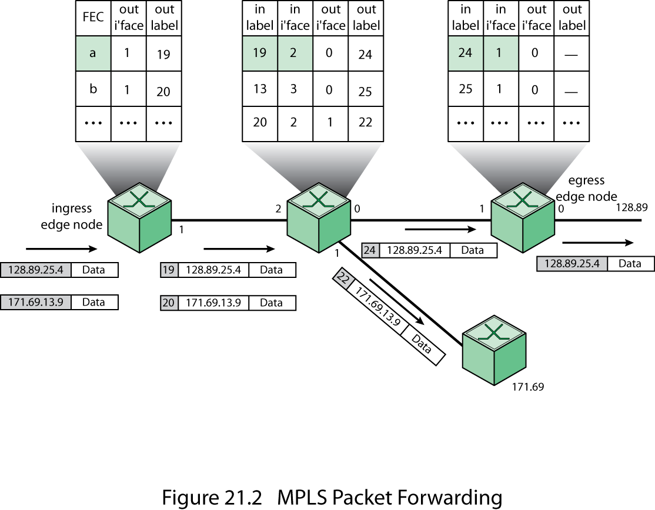
MPLS Packet Forwarding
Notes:
Stallings DCC9e Figure 21.2 shows the label-handling and forwarding operation in more detail. Each LSR maintains a forwarding table for each LSP passing through the LSR. When a labeled packet arrives, the LSR indexes the forwarding table to determine the next hop. For scalability, as was mentioned, labels have local significance only. Thus, the LSR removes the incoming label from the packet and attaches the matching outgoing label before forwarding the packet. The ingress edge LSR determines the FEC for each incoming unlabeled packet and, on the basis of the FEC, assigns the packet to a particular LSP, attaches the corresponding label, and forwards the packet. In this example, the first packet arrives at the edge LSR, which reads the IP header for the destination address prefix, 128.89. The LSR then looks up the destination address in the switching table, inserts a label with a 20-bit label value of 19, and forwards the labeled packet out interface 1. This interface is attached via a link to a core LSR, which receives the packet on its interface 2. The LSR in the core reads the label and looks up its match in its switching table, then replaces label 19 with label 24, and forwards it out interface 0. The egress LSR reads and looks up label 4 in its table, which says to strip the label and forward the packet out interface 0.

Slide 15
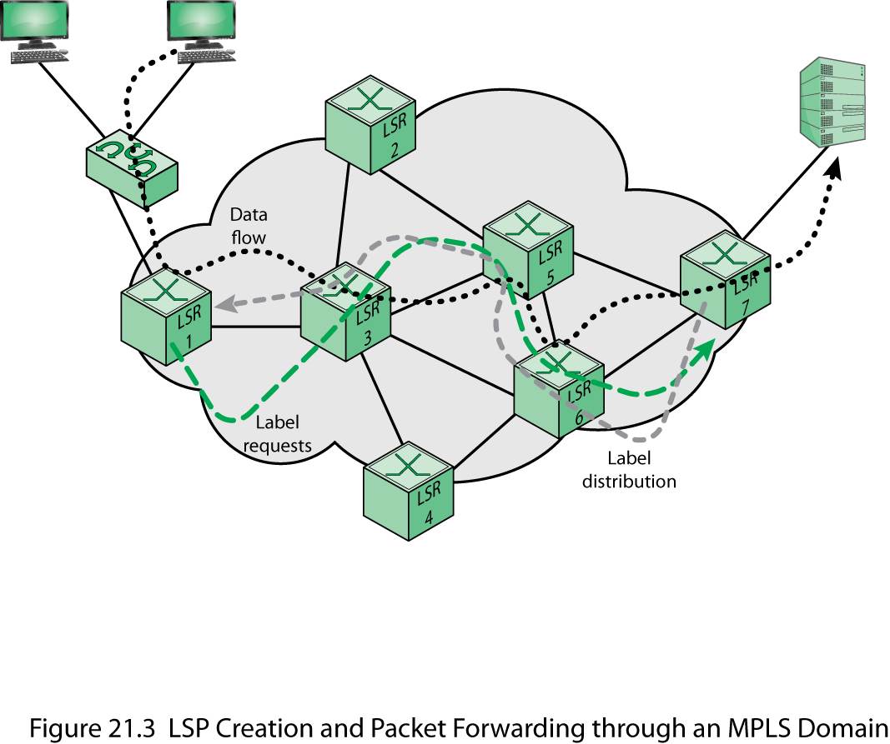
LSP Creation and Packet Forwarding
Notes:
Let us now look at an example that illustrates the various stages of operation of MPLS, using Stallings DCC9e Figure 21.3. We examine the path of a packet as it a source workstation to a destination server. Across the MPLS network, the packet enters at egress node LSR 1. Assume that this is the first occurrence of a packet on a new flow of packets, so that LSR 1 does not have a label for the packet. LSR 1 consults the IP header to find the destination address and then determine the next hop. Assume in this case that the next hop is LSR 3. Then, LSR 1 initiates a label request toward LSR 3. This request propagates through the network as indicated by the dashed green line.
Each intermediate router receives a label from its downstream router starting from LSR 7 and going upstream until LSR 1, setting up an LSP. The LSP setup is indicated by the dashed grey line. The setup can be performed using LDP and may or may not involve traffic engineering considerations.
LSR 1 is now able to insert the appropriate label and forward the packet to LSR 3. Each subsequent LSR (LSR 5, LSR 6, LSR 7) examines the label in the received packet, replaces it with the outgoing label, and forwards it. When the packet reaches LSR 7, the LSR removes the label because the packet is departing the MPLS domain and delivers the packet to the destination.

Slide 16
Label Stacking
one of the most powerful features of MPLS
processing is always based on the top label
at any LSR a label may be removed or added
allows creation of tunnels
tunnel refers to traffic routing being determined by labels
provides considerable flexibility
unlimited stacking
UNLIMITED
STACKING
Notes:
Label Stacking
One of the most powerful features of MPLS is label stacking. A labeled packet may carry a number of labels, organized as a last-in-first-out stack. Processing is always based on the top label. At any LSR, a label may be added to the stack (push operation) or removed from the stack (pop operation). Label stacking allows the aggregation of LSPs into a single LSP for a portion of the route through a network, creating a tunnel. The term tunnel refers to the fact that traffic routing is determined by labels, and is exercised below normal IP routing and filtering mechanisms. At the beginning of the tunnel, an LSR assigns the same label to packets from a number of LSPs by pushing the label onto each packet's stack. At the end of the tunnel, another LSR pops the top element from the label stack, revealing the inner label. This is similar to ATM, which has one level of stacking (virtual channels inside virtual paths) but MPLS supports unlimited stacking.
Label stacking provides considerable flexibility. An enterprise could establish MPLS-enabled networks at various sites and establish a number of LSPs at each site. The enterprise could then use label stacking to aggregate multiple flows of its own traffic before handing it to an access provider. The access provider could aggregate traffic from multiple enterprises before handing it to a larger service provider. Service providers could aggregate many LSPs into a relatively small number of tunnels between points of presence. Fewer tunnels means smaller tables, making it easier for a provider to scale the network core.

Slide 17
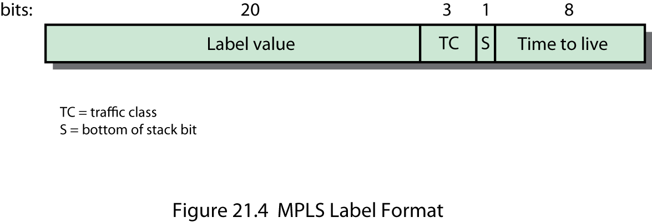
Label Format
defined in RFC 3032
32-bit field consisting of:
Label value
Traffic class (TC)
S
Time to live (TTL)
Notes:
Label Format
An MPLS label is a 32-bit field consisting of the following elements (Stallings DCC9e Figure 21.4), defined in RFC 3032:
Label value: Locally significant 20-bit label. Values 0 through 15 are reserved.
Traffic class (TC): 3 bits used to carry traffic class information.
S: Set to one for the oldest entry in the stack, and zero for all other entries. Thus, this bit marks the bottom of the stack.
Time to live (TTL): 8 bits used to encode a hop count, or time to live, value.

Slide 18
Traffic Class (TC)
RFCs 3270 and 5129
no unique definition of the TC bits has been standardized
DS:
assign a unique label value to each DS per-hop-behavior scheduling class
map the drop precedence into the TC field
ECN:
three possible ECN values are mapped into the TC field
Notes:
TRAFFIC CLASS
RFCs 3270 and 5129 discuss the use of the TC field to convey information to support Differentiated Services (DS) and Explicit Congestion Notification (ECN), respectively. With respect to DS, one approach is to assign a unique label value to each DS per-hop-behavior scheduling class, in which case, the TC field is not necessarily needed. The other approach is to map the drop precedence or some other DS information into the TC field. With respect to ECN, the three possible ECN values (not ECN capable, ECN capable, congestion marked) are mapped into the TC field. RFC 5129 discusses strategies in which both DS and ECN might be supported in the TC field. At present, no unique definition of the TC bits has been standardized.

Slide 19
Time to Live Field (TTL)
key field in the IP packet header
decremented at each router and packet is dropped if the count falls to zero
done to avoid looping
having the packet remain too long in the Internet due to faulty routing
included in the label so that the TTL function is still supported
Notes:
TIME TO LIVE PROCESSING
A key field in the IP packet header is the TTL field (IPv4, Figure 2.7a), or hop limit (IPv6, Figure 2.7b). In an ordinary IP-based internet, this field is decremented at each router and the packet is dropped if the count falls to zero. This is done to avoid looping or having the packet remain too long in the Internet due to faulty routing. Because an LSR does not examine the IP header, the TTL field is included in the label so that the TTL function is still supported. The rules for processing the TTL field in the label are as follows:
1. When an IP packet arrives at an ingress edge LSR of an MPLS domain, a single label stack entry is added to the packet. The TTL value of this label stack entry is set to the value of the IP TTL value. If the IP TTL field needs to be decremented, as part of the IP processing, it is assumed that this has already been done.
2. When an MPLS packet arrives at an internal LSR of an MPLS domain, the TTL value in the top label stack entry is decremented. Then
(a) If this value is zero, the MPLS packet is not forwarded. Depending on the label value in the label stack entry, the packet may be simply discarded, or it may be passed to the appropriate "ordinary" network layer for error processing (e.g., for the generation of an ICMP error message).
(b) If this value is positive, it is placed in the TTL field of the top label stack entry for the outgoing MPLS packet, and the packet is forwarded. The outgoing TTL value is a function solely of the incoming TTL value and is independent of whether any labels are pushed or popped before forwarding. There is no significance to the value of the TTL field in any label stack entry that is not at the top of the stack.
3. When an MPLS packet arrives at an egress edge LSR of an MPLS domain, the TTL value in the single label stack entry is decremented and the label is popped, resulting in an empty label stack. Then
(a) If this value is zero, the IP packet is not forwarded. Depending on the label value in the label stack entry, the packet may be simply discarded, or it may be passed to the appropriate "ordinary" network layer for error processing.
(b) If this value is positive, it is placed in the TTL field of the IP header, and the IP packet is forwarded using ordinary IP routing. Note that the IP header checksum must be modified prior to forwarding

Slide 20
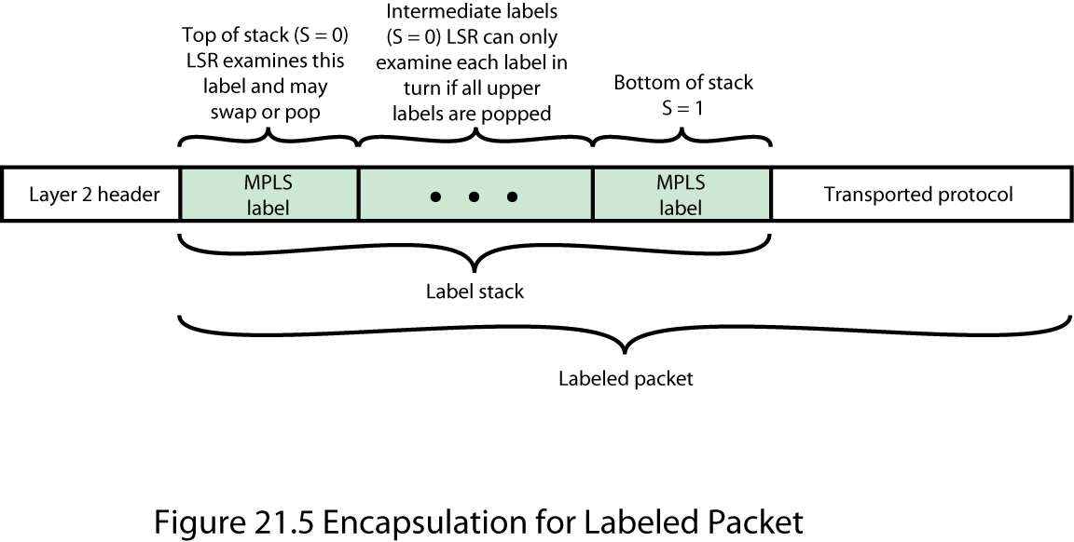
Label Placement
Notes:
Label Placement
The label stack entries appear after the data link layer headers, but before any network layer headers. The top of the label stack appears earliest in the packet (closest to the data link header), and the bottom appears latest (closest to the network layer header), as shown in Stallings DCC9e Figure 21.5. The network layer packet immediately follows the label stack entry that has the S bit set.

Slide 21
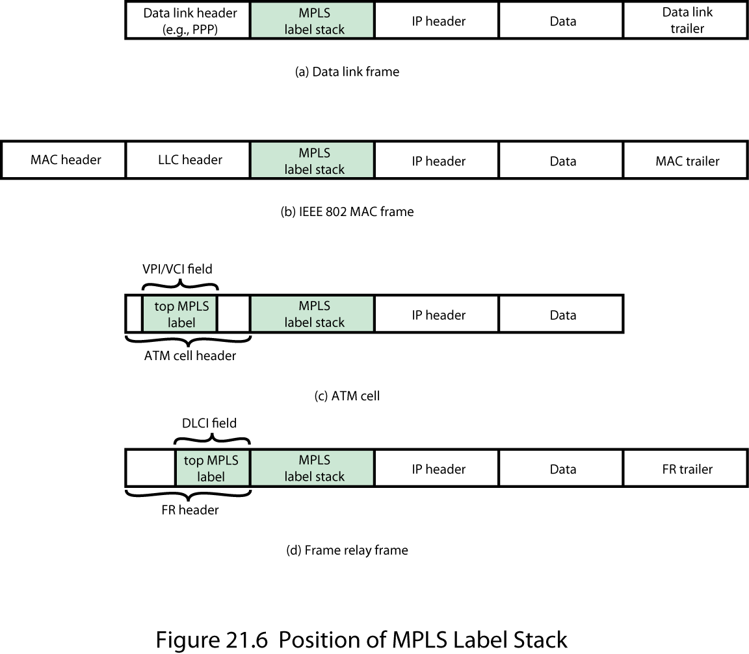
Label Stack
Notes:
In data link frame, such as for PPP (point-to-point protocol), the label stack appears between the IP header and the data link header (Stallings DCC9e Figure 21.6a). For an IEEE 802 frame, the label stack appears between the IP header and the LLC (logical link control) header (Figure 21.6b).
If MPLS is used over a connection-oriented network service, a slightly different approach may be taken, as shown in Figures 21.6c and d. For ATM cells, the label value in the topmost label is placed in the VPI/VCI field in the ATM cell header. The entire top label remains at the top of the label stack, which is inserted between the cell header and the IP header. Placing the label value in the ATM cell header facilitates switching by an ATM switch, which would, as usual, only need to look at the cell header. Similarly, the topmost label value can be placed in the DLCI (data link connection identifier) field of a frame relay header. Note that in both these cases, the Time to Live field is not visible to the switch and so is not decremented. The reader should consult the MPLS specifications for the details of the way this situation is handled.

Slide 22
FECs, LSPs, and Labels
traffic is grouped into FECs
traffic in an FEC transits an MPLS domain along an LSP
individual packets in an FEC are uniquely identified
at each LSR each labeled packet is forwarded on the basis of its label value
Notes:
To understand MPLS, it is necessary to understand the operational relationship among FECs, LSPs, and labels. The specifications covering all of the ramifications of this relationship are lengthy. In the remainder of this section, we provide a summary.
The essence of MPLS functionality is that traffic is grouped into FECs. The traffic in an FEC transits an MPLS domain along an LSP. Individual packets in an FEC are uniquely identified as being part of a given FEC by means of a locally significant label. At each LSR, each labeled packet is forwarded on the basis of its label value, with the LSR replacing the incoming label value with an outgoing label value.
The overall scheme described in the previous paragraph imposes a number of requirements. Specifically,
1. Each traffic flow must be assigned to a particular FEC.
2. A routing protocol is needed to determine the topology and current conditions in the domain so that a particular LSP can be assigned to an FEC. The routing protocol must be able to gather and use information to support the QoS requirements of the FEC.
3. Individual LSRs must become aware of the LSP for a given FEC, must assign an incoming label to the LSP, and must communicate that label to any other LSR that may send it packets for this FEC.
The first requirement is outside the scope of the MPLS specifications. The assignment needs to be done either by manual configuration, or by means of some signaling protocol, or by an analysis of incoming packets at ingress LSRs.

Slide 23
LSP Topology
unique ingress and egress LSR
single path through the MPLS domain is needed
unique egress LSR, multiple ingress LSRs
traffic assigned to a single FEC can arise from different sources that enter the network at different ingress LSRs
multiple egress LSRs for unicast traffic
RFC 3031
multicast
RFC 5332
Notes:
Before looking at the other two requirements, let us consider topology of LSPs. We can classify these in the following manner:
Unique ingress and egress LSR: In this case a single path through the MPLS domain is needed.
Unique egress LSR, multiple ingress LSRs: If traffic assigned to a single FEC can arise from different sources that enter the network at different ingress LSRs, then this situation occurs. An example is an enterprise intranet at a single location but with access to an MPLS domain through multiple MPLS ingress LSRs. This situation would call for multiple paths through the MPLS domain, probably sharing a final few hops.
Multiple egress LSRs for unicast traffic: RFC 3031 states that most commonly, a packet is assigned to an FEC based (completely or partially) on its network layer destination address. If not, then it is possible that the FEC would require paths to multiple distinct egress LSRs. However, more likely, there would be a cluster of destination networks all of which are reached via the same MPLS egress LSR.
Multicast: RFC 5332 defines techniques for handling multicast packets.

Slide 24
Route Selection
refers to the selection of an LSP for a particular FEC
supports two options:
hop-by-hop routing
each LSR independently chooses the next hop for each FEC
does not readily support traffic engineering or policy routing
explicit routing
a single LSR specifies some or all of the LSRs
can be set up ahead of time or dynamically
Notes:
Route Selection
Route selection refers to the selection of an LSP for a particular FEC. The MPLS architecture supports two options: hop-by-hop routing and explicit routing.
With hop-by-hop routing, each LSR independently chooses the next hop for each FEC. RFC 3031 implies that this option makes use of an ordinary routing protocol, such as OSPF. This option provides some of the advantages of MPLS, including rapid switching by labels, the ability to use label stacking, and differential treatment of packets from different FECs following the same route. However, because of the limited use of performance metrics in typical routing protocols, hop by hop routing does not readily support traffic engineering or policy routing (defining routes based on some policy related to QoS, security, or some other consideration).
With explicit routing, a single LSR, usually the ingress or egress LSR, specifies some or all of the LSRs in the LSP for a given FEC. For strict explicit routing, an LSR specifies all of the LSRs on an LSP. For loose explicit routing, only some of the LSRs are specified. Explicit routing provides all of the benefits of MPLS, including the ability to do traffic engineering and policy routing.
Explicit routes can be selected by configuration, that is, set up ahead of time, or dynamically. Dynamic explicit routing would provide the best scope for traffic engineering. For dynamic explicit routing, the LSR setting up the LSP would need information about the topology of the MPLS domain as well as QoS-related information about that domain. An MPLS traffic engineering specification (RFC 2702) suggests that the QoS-related information falls into two categories:
A set of attributes associated with an FEC or a collection of similar FECs that collectively specify their behavioral characteristics.
A set of attributes associated with resources (nodes, links) that constrain the placement of LSPs through them.
A routing algorithm that takes into account the traffic requirements of various flows and that takes into account the resources available along various hops and through various nodes is referred to as a constraint-based routing algorithm. In essence, a network that uses a constraint-based routing algorithm is aware of current utilization, existing capacity, and committed services at all times. Traditional routing algorithms, such as OSPF and BGP, do not employ a sufficient array of cost metrics in their algorithms to qualify as constraint based. Furthermore, for any given route calculation, only a single cost metric (e.g., number of hops, delay) can be used. For MPLS, it is necessary either to augment an existing routing protocol or to deploy a new one. For example, an enhanced version of OSPF has been defined (RFC 2676) that provides at least some of the support required for MPLS. Examples of metrics that would be useful to constraint based routing are:
Maximum link data rate
Current capacity reservation
Packet loss ratio
Link propagation delay

Slide 25
Requirements for Label Distribution
label distribution protocol enables two LSRs to learn each other’s MPLS capabilities
RFC 3031 refers to a new label distribution protocol and to enhancements of existing protocols
hop-by-hop route selection
no attention is paid to traffic engineering or policy routing concerns
ordinary routing protocol is used to determine the next hop by each LSR
Notes:
Requirements for Label Distribution
Route selection consists of defining an LSP for an FEC. A separate function is the actual setting up of the LSP. For this purpose, each LSR on the LSP must:
1. Assign a label to the LSP to be used to recognize incoming packets that belong to the corresponding FEC.
2. Inform all potential upstream nodes (nodes that will send packets for this FEC to this LSR) of the label assigned by this LSR to this FEC, so that these nodes can properly label packets to be sent to this LSR.
3. Learn the next hop for this LSP and learn the label that the downstream node (LSR that is the next hop) has assigned to this FEC. This will enable this LSR to map an incoming label to an outgoing label.
The first item in the preceding list is a local function. Items 2 and 3 must either be done by manual configuration or require the use of some sort of label distribution protocol. Thus, the essence of a label distribution protocol is that it enables one LSR to inform others of the label/FEC bindings it has made. In addition, a label distribution protocol enables two LSRs to learn each other's MPLS capabilities. The MPLS architecture does not assume a single label distribution protocol but allows for multiple such protocols. Specifically, RFC 3031 refers to a new label distribution protocol and to enhancements to existing protocols, such as RSVP and BGP, to serve the purpose.
The relationship between label distribution and route selection is complex. It is best to look at in the context of the two types of route selection.
With hop-by-hop route selection, no specific attention is paid to traffic engineering or policy routing concerns, as we have seen. In such a case, an ordinary routing protocol such as OSPF is used to determine the next hop by each LSR. A relatively straightforward label distribution protocol can operate using the routing protocol to design routes.
With explicit route selection, a more sophisticated routing algorithm must be implemented, one that does not employ a single metric to design a route. In this case, a label distribution protocol could make use of a separate route selection protocol, such as an enhanced OSPF, or incorporate a routing algorithm into a more complex label distribution protocol.

Slide 26
Label Distribution Protocol
protocols that communicate which label goes with which Forwarding Equivalence Class (FEC)
Label Distribution Protocol (LDP; RFC 5036)
Resource Reservation Protocol – Traffic Engineering (RSVP-TE; RFC 3209)
multiprotocol BGP as extended for Layer 3 VPNs (L3VPNs; RFC 4364)
once a route is established LDP is used to establish the LSP and assign labels
Notes:
Label Distribution Protocol
Protocols that communicate which label goes with which FEC are called label distribution protocols. A number of label distribution protocols exist, most commonly Label Distribution Protocol (LDP; RFC 5036), Resource Reservation Protocol-Traffic Engineering ( RSVP-TE; RFC 3209) and multiprotocol BGP as extended for Layer 3 VPNs (L3VPNs; RFC 4364). LDP has emerged as the preferred solution and we provide a brief introduction here.
LDP has a simple objective: it is a protocol defined for distributing labels. It is the set of procedures and messages by which Label Switching Routers (LSRs) establish Label Switched Paths (LSPs) through a network by mapping network-layer routing information directly to data-link layer switched paths. These LSPs may have an endpoint at a directly attached neighbor (comparable to IP hop-by-hop forwarding), or may have an endpoint at a network egress node, enabling switching via all intermediary nodes. LDP associates a Forwarding Equivalence Class (FEC) with each LSP it creates. The FEC associated with an LSP specifies which packets are mapped to that LSP. LSPs are extended through a network as each LSR splices incoming labels for a FEC to the outgoing label assigned to the next hop for the given FEC.
Two LSRs which use LDP to exchange FEC- label binding information are known as LDP peers. In order to exchange information, two LDP peers first establish a session over a TCP connection. LDP includes a mechanism by which an LSR can discover potential LDP peers. The discovery mechanism makes it unnecessary for operators to explicitly configure each LSR with its LDP peers. When an LSR discovers another LSR it follows the LDP session setup procedure to establish an LDP session. By means of this procedure the LSRs establish a session TCP connection and use it to negotiate parameters for the session, such as the label distribution method to be used. After the LSRs agree on the parameters, the session is operational and the LSRs use the TCP connection for label distribution.
LDP supports two different methods for label distribution. An LSR using Downstream Unsolicited distribution advertises FEC-label bindings to its peers when it is ready to forward packets in the FEC by means of MPLS. An LSR using Downstream on Demand distribution provides FEC-label bindings to a peer in response to specific requests from the peer for a label for the FEC.
LDP depends on a routing protocol, such as OSPF, to initially establish reachability between two LSRs. The routing protocol can also be used to define the route for the LSP. Alternatively, traffic engineering considerations can determine the exact route of the LSP, as discussed in Section 21.7. Once a route is established for an LSP, LDP is used to establish the LSP and assign labels. Figure 21.7 suggests the operation of LDP. Each LSP is unidirectional, and label assignment propagate back from the end point of the LSP to the originating point.

Slide 27

LDP Messages
Discovery
each LSR announces and maintains its presence in a network
Hello messages
Session establishment and maintenance
LDP peers
Advertisement
create, change, and delete label mappings for FECs
Notification messages
provide advisory information and to signal error information
Notes:
LDP Messages
LDP operates by the exchange of messages over a TCP connection between LDP peers. There are four categories of messages, reflecting the four major functions of LDP:
Discovery: Each LSR announces and maintains its presence in a network. LSRs indicate their presence in a network by sending Hello messages periodically. Hello messages are transmitted as UDP packets to the LDP port at the group multicast address for all routers on the subnet.
Session establishment and maintenance: If two LSRs have discovered each other by means of the LDP Hellos, they can then establish, maintain, and terminate sessions as LDP peers. When a router establishes a session with another router learned through the Hello message, it uses the LDP initialization procedure over TCP transport. When the initialization procedure is completed successfully, the two routers are LDP peers and can exchange advertisement messages
Advertisement: Advertising label mappings or label bindings is the main purpose of LDP. Advertisement messages are used to create, change, and delete label mappings for FECs. Requesting a label or advertising a label mapping to a peer is a decision made by the local router. In general, the router requests a label mapping from a neighboring router when it needs one and advertises a label mapping to a neighboring router when it wants the neighbor to use a label.
Notification messages: Used to provide advisory information and to signal error information. LDP sends notification messages to report errors and other events of interest. There are two kinds of LDP notification messages:
—Error notifications, which signal fatal errors. If a router receives an error notification from a peer for an LDP session, it terminates the LDP session by closing the TCP transport connection for the session and discarding all label mappings learned through the session.
—Advisory notifications, which pass information to a router about the LDP session or the status of some previous message received from the peer.

Slide 28
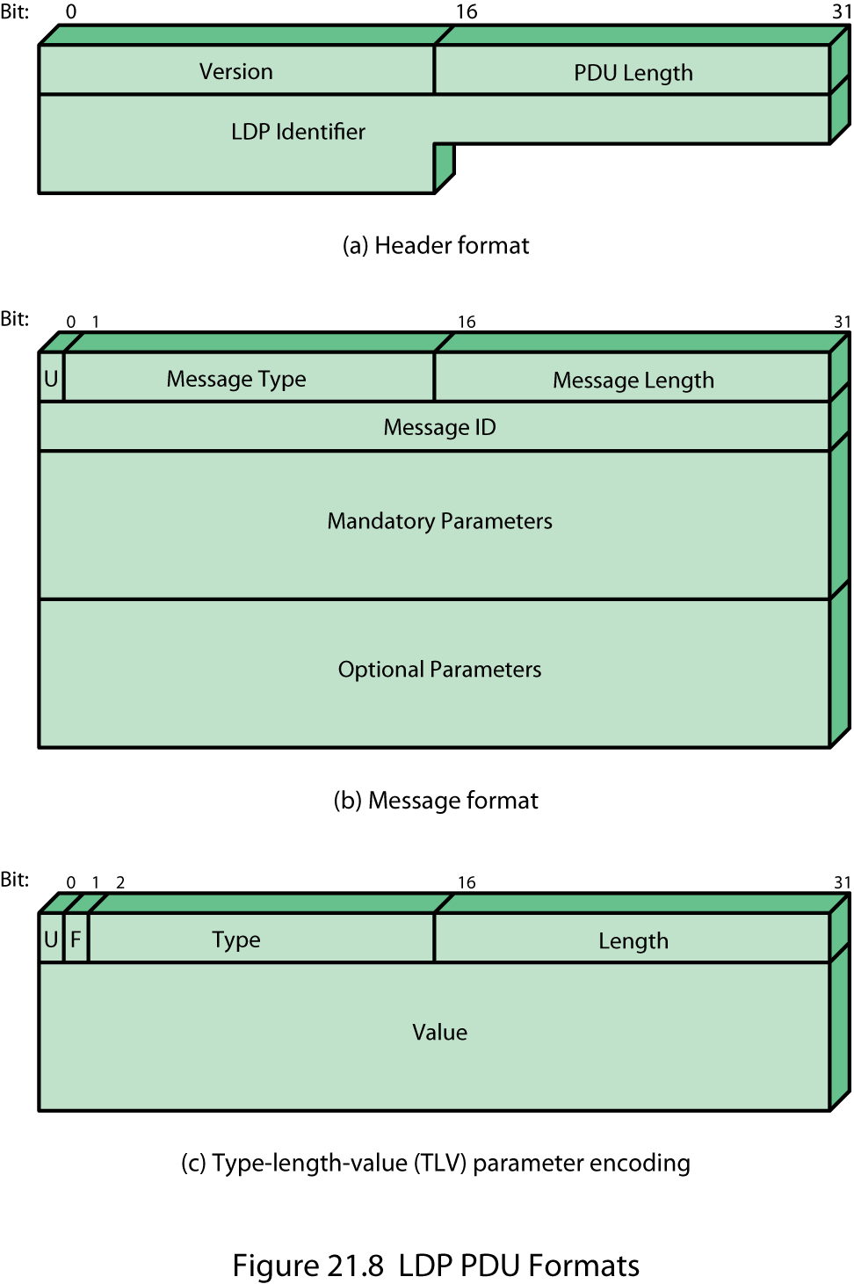
LDP Message Format
Notes:
Stallings DCC9e Figure 21.8 illustrates the format of LDP messages. Each LDP protocol data unit (PDU) consists of an LDP header followed by one or more LDP messages. The header contains three fields:
Version: Version number for this protocol. The current version is 1.
PDU length: Length of this PDU in octets.
LDP identifier: Identifies the LSR uniquely.
Each message consists of the following fields:
U bit: Indicates how to handle a message of an unknown type (forward or discard). This facilitates backward compatibility.
Message type: Identifies the specific type of message (e.g., Hello).
Message length: Length of this message in octets.
Message ID: Identifies this specific message with a sequence number. This is used to facilitate identifying subsequent Notification messages that may apply to this message.
Mandatory parameters: Variable length set of required message parameters. Some messages have no required parameters.
Optional parameters: Variable length set of optional message parameters. Many messages have no optional parameters.
Each parameter has a type-length-value (TLV) format. An LDP TLV is encoded as a 2 octet field that uses 14 bits to specify a Type and 2 bits to specify behavior when an LSR doesn't recognize the Type, followed by a 2 octet Length field, followed by a variable length Value field.

Slide 29
Traffic Engineering
RFC 2702
allocate traffic to the network to maximize utilization of the network capacity
ensure the most desirable route through the network while meeting QoS requirements
Notes:
RFC 2702 (Requirements for Traffic Engineering Over MPLS) describes traffic engineering as follows:
Traffic Engineering. Traffic Engineering (TE) is concerned with performance optimization of operational networks. In general, it encompasses the application of technology and scientific principles to the measurement, modeling, characterization, and control of Internet traffic, and the application of such knowledge and techniques to achieve specific performance objectives. The aspects of Traffic Engineering that are of interest concerning MPLS are measurement and control.
The goal of MPLS traffic engineering is twofold. First, traffic engineering seeks to allocate traffic to the network to maximize utilization of the network capacity. And second, traffic engineering seeks to ensure the most desirable route through the network for packet traffic, taking into account the QoS requirements of the various packet flows. In performing traffic engineering, MPLS may override the shortest path or least-cost route selected by the interior routing protocol for a given source-destination flow.

Slide 30
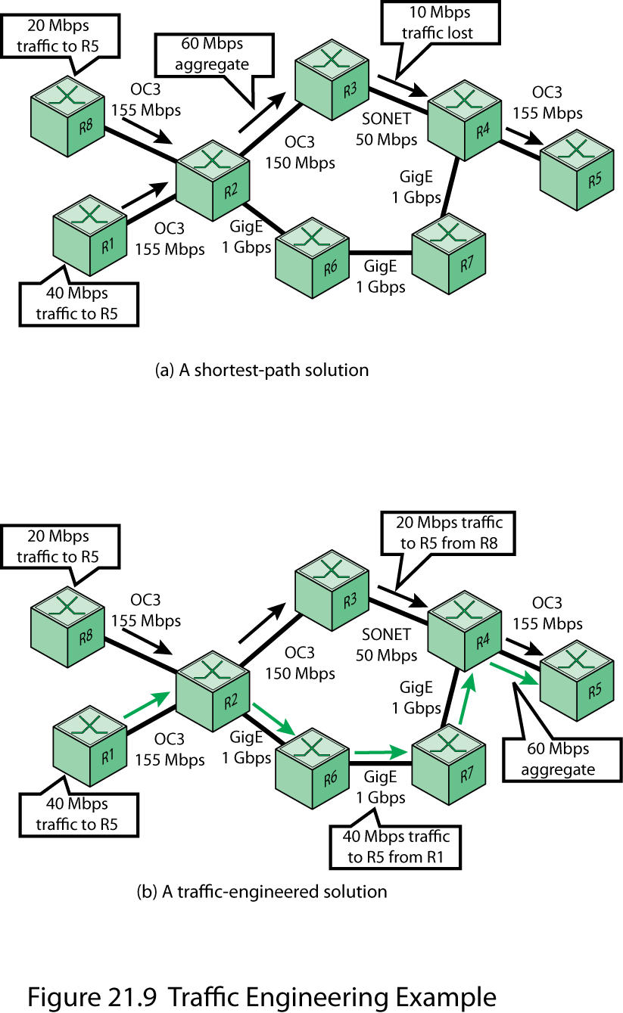
Example of Traffic Engineering
Notes:
Stallings DCC9e Figure 21.9 provides a simple example of traffic engineering. Both R1 and R8 have a flow of packets to send to R5. Using OSPF or some other routing protocol, the shortest path is calculated as R2-R3-R4. However, if we assume that R8 has a steady-state traffic flow of 20 Mbps and R1 has a flow of 40 Mbps, then the aggregate flow over this route will be 60 Mbps, which will exceed the capacity of the R3-R4 link. As an alternative, a traffic engineering approach is to determine a route from source to destination ahead of time and reserve the required resources along the way by setting up a LSP and associating resource requirements with that LSP. In this case, the traffic from R8 to R5 follows the shortest route, but the traffic from R1 to R5 follows a longer route that avoids overloading the network.

Slide 31
Elements of MPLS Traffic Engineering (MPLS TE)
Information distribution
a link state protocol is necessary to discover the topology of the network
Path calculation
shortest path through a network that meets the resource requirements of the traffic flow
Path setup
signaling protocol to reserve the resources for a traffic flow and to establish the LSP
Traffic forwarding
accomplished with MPLS using the LSP
Notes:
Elements of MPLS Traffic Engineering
MPLS TE works by learning about the topology and resources available in a network. It then maps the traffic flows to a particular path based on the resources that the traffic flow requires and the available resources. MPLS TE builds unidirectional LSPs from a source to the destination, which are then used for forwarding traffic. The point where the LSP begins is called LSP headend or LSP source, and the node where the LSP ends is called LSP tailend or LSP tunnel destination.
LSP tunnels allow the implementation of a variety of policies related to network performance optimization. For example, LSP tunnels can be automatically or manually routed away from network failures, congestion, and bottlenecks. Furthermore, multiple parallel LSP tunnels can be established between two nodes, and traffic between the two nodes can be mapped onto the LSP tunnels according to local policy.
The following components work together to implement MPLS TE:
Information distribution: A link state protocol, such as Open Shortest Path First (OSPF), is necessary to discover the topology of the network. OSPF is enhanced to carry additional information related to TE, such as bandwidth available and other related parameters. OSPF uses Type 10 (Opaque) Link State Advertisements (LSAs) for this purpose.
Path calculation: Once the topology of the network and the alternative routes are known, a constraint-based routing scheme is used for finding the shortest path through a particular network that meets the resource requirements of the traffic flow. The Constrained Shortest Path First (CSPF) algorithm (discussed subsequently), which operates on the LSP headend is used for this functionality.
Path setup: is a signaling protocol to reserve the resources for a traffic flow and to establish the LSP for a traffic flow. IETF has defined two alternative protocols for this purpose. The Resource Reservation Protocol (RSVP) has been enhanced with TE extensions for carrying labels and building the LSP. The other approach is an enhancement to LDP known as Constraint-based Routing Label Distribution Protocol (CR-LDP).
Traffic forwarding: This is accomplished with MPLS, using the LSP set up by the traffic engineering components just described..

Slide 32
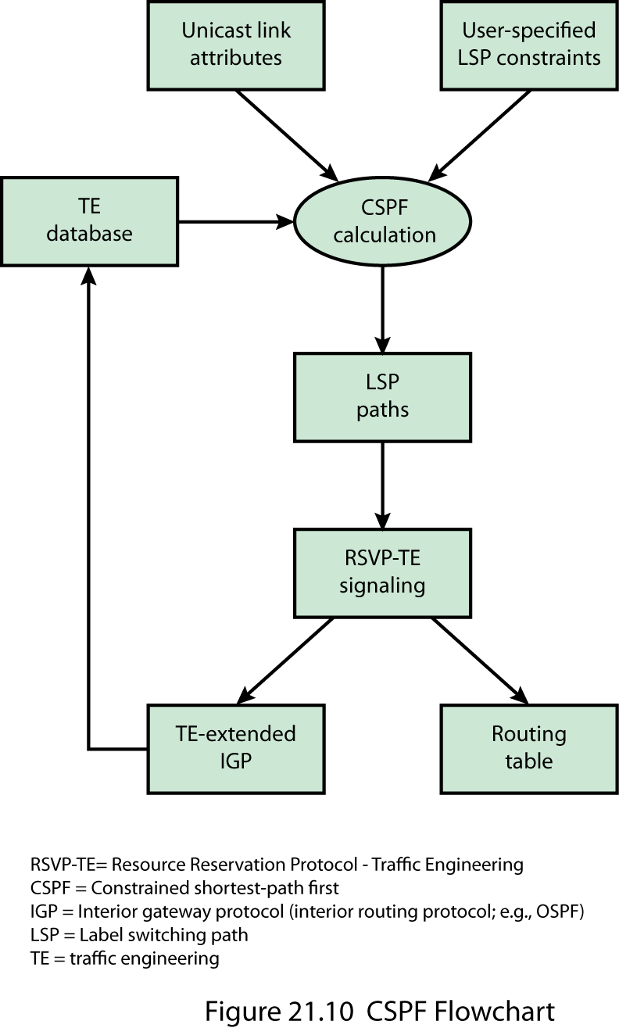
CSPF Flowchart
Notes:
The CSPF algorithm is an enhanced version of the shortest path first (SPF) algorithm used in OSPF. CSPF computes paths taking into account to multiple constraints. When computing paths for LSPs, CSPF considers the topology of the network, the attributes of the individual links between LSRs, and the attributes of existing LSPs. CSPF attempts to satisfy the requirements for a new LSP while minimizing congestion by balancing the network load.
Stallings DCC9e Figure 21.10 suggests the context in which CSPF is used. In setting up a new LSP, CSPF operates on the basis of three inputs:
Unicast link attributes: These include the capacity of the link and the administrative groups that are allowed to use this link. For example, some links may be reserved for the exclusive use of one or several groups or, alternative, some groups may be specifically excluded from using this link. The term color is used to refer to a unique administrative group.
User-specified LSP constraints: When an application request an LSP to a given unicast destination, the application specifies the required attributes of the path, including data rate, hop limitations, link color requirements, priority, and explicit route requirements.
Traffic engineering database: The TE database maintains current topology information, current reservable capacity of links, and link colors.
Based on these three inputs, the CSPF algorithm selects a route for the requested LSP. This information is used by RSVP-TE to set up the path and to provide information to the routing algorithm, which in turn updates the TE database.
In general terms, the CSPF path selection procedure involves the following steps:
1. If multiple LSPs are to be determined, calculate LSPs one at a time, beginning with the highest priority LSP. Among LSPs of equal priority, CSPF starts with those that have the highest capacity requirement.
2. Prune the TE database of all the links that do not have sufficient reservable capacity. If the LSP configuration includes the include statement, prune all links that do not share any included colors. If the LSP configuration includes the exclude statement, prune all links that contain excluded colors and do not contain a color.
3. Find the shortest path towards the LSP's egress router, taking into account explicit-path constraints. For example, if the path must pass through Router A, two separate SPFs are computed, one from the ingress router to Router A, the other from Router A to the egress router.
4. If several equal-cost paths remain, select the one with the fewest number of hops.
5. If several equal-cost paths remain, apply the CSPF load-balancing rule configured on the LSP.

Slide 33
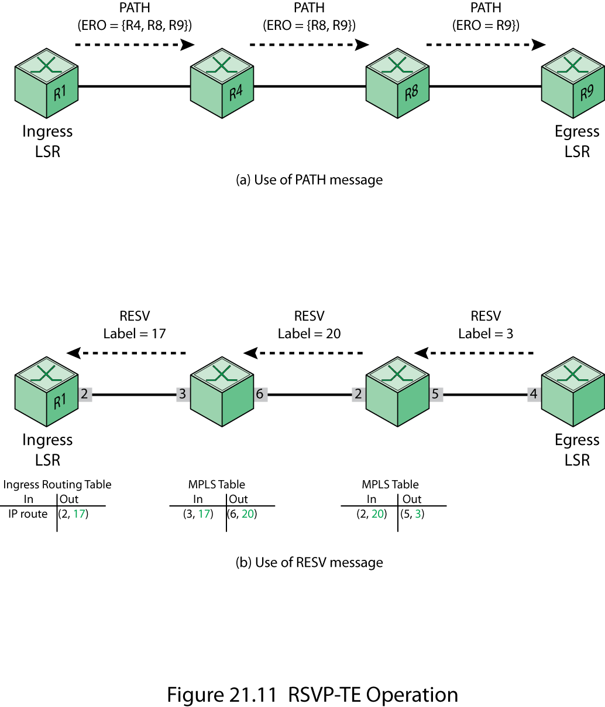
RSVP – TE Operation
Notes:
RSVP-TE
Early in the MPLS standardization process, it became clear that a protocol was needed that would enable providers to set up LSPs that took into account QoS and traffic engineering parameters. Development of this type of signaling protocol proceeded on two different tracks:
Extensions to RSVP for setting up MPLS tunnels, known as RSVP-TE [RFC3209]
Extensions to LDP for setting constraint based LSPs [RFC3212]
The motivation for the choice of protocol in both cases was straightforward. Extending RSVP-TE to do in an MPLS environment what it already was doing (handling QoS information and reserving resources) in an IP environment is comprehensible; you only have to add the label distribution capability. Extending a native MPLS protocol like LDP, which was designed to do label distribution, to handle some extra TLVs with QoS information is also not revolutionary. Ultimately, the MPLS working group announced, in RFC 3468, that RSVP-TE is the preferred solution.
In general terms, RSVP-TE operates by associating an MPLS label with an RSVP flow. RSVP is used to reserve resources and to define an explicit router for an LSP tunnel. Stallings DCC9e Figure 21.11 illustrates the basic operation of RSVP-TE. An ingress node uses the RSVP PATH message to request an LSP to be defined along an explicit route. The PATH message includes a label request object and an explicit route object (ERO). The ERO defines the explicit route to be followed by the LSP.
The destination node of a label-switched path responds to a LABEL_REQUEST by including a LABEL object in its response RSVP Resv message. The LABEL object is inserted in the filter spec list immediately following the filter spec to which it pertains. The Resv message is sent back upstream towards the sender, following the path state created by the Path message, in reverse order.

Slide 34
Virtual Private Network (VPN)
private network configured within a public network in order to take advantage of management facilities of larger networks
traffic designated as VPN traffic can only go from a VPN source to a destination in the same VPN
widely used by enterprises to:
create wide area networks (WANs)
provide site-to-site communications to branch offices
allow mobile user to dial up their company LANs
Notes:
A virtual private network (VPN) is a private network that is configured within a public network (a carrier's network or the Internet) in order to take advantage of the economies of scale and management facilities of large networks. VPNs are widely used by enterprises to create wide area networks (WANs) that span large geographic areas, to provide site-to-site connections to branch offices, and to allow mobile users to dial up their company LANs. From the point of view of the provider, the pubic network facility is shared by many customers, with the traffic of each customer segregated from other traffic. Traffic designated as VPN traffic can only go from a VPN source to a destination in the same VPN. It is often the case that encryption and authentication facilities are provided for the VPN.
The subject of VPNs, even when limited to MPLS-enabled VPNs, is extraordinarily complex. In this section, we provide a brief overview of two of the most common approaches to VPN implementation using MPLS: the layer 2 VPNs (L2VPN) and the layer 3 VPN (L3VPN).

Slide 35
VPN Terminology
Notes:
Stallings DCC9e Table 21.2, based on RFC 4026 (Provider Provisioned Virtual Private Network Terminology), defines key VPN terms used in our discussion

Slide 36
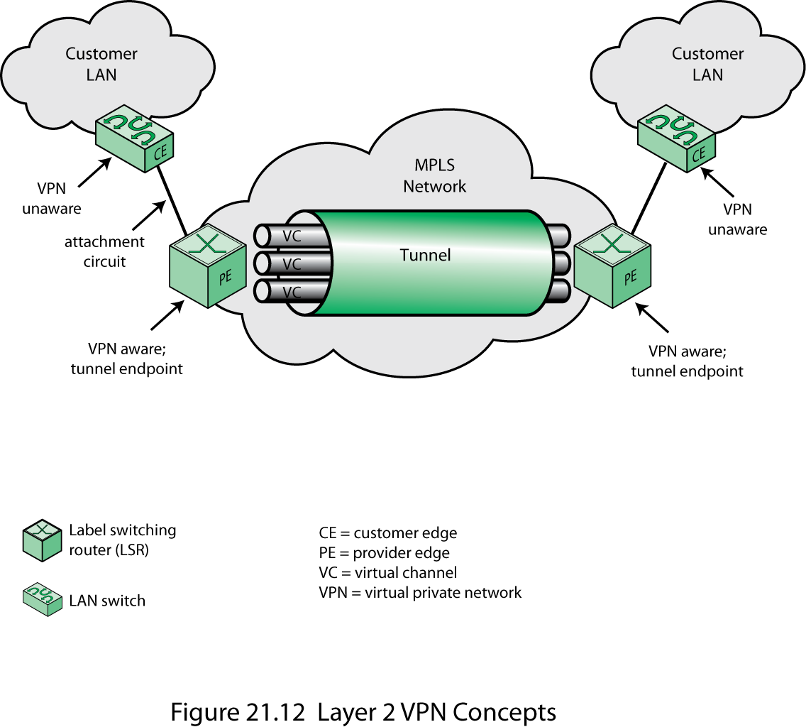
Layer 2 VPN Concepts
Notes:
Layer 2 Virtual Private Network
With a layer 2 VPN, there is mutual transparency between the customer network and the provider network. In effect, the customer requests a mesh of unicast LSPs among customer switches that attach to the provider network. Each LSP is viewed as a layer 2 circuit by the customer. In a L2VPN, the provider's equipment forwards customer data based on information in the Layer 2 headers, such as an Ethernet MAC address, an ATM virtual channel identifier, or a frame relay data link connection identifier.
Stallings DCC9e Figure 21.12 depicts key elements in a L2VPN. Customers connect to the provider by means of a layer 2 device, such as an Ethernet switch, or a frame relay or ATM node; the customer device that connects to the MPLS network is generally referred to as a customer edge (CE) device. The MPLS edge router is referred to as a provider edge (PE) device. The link between the CE and the PE operates at the link layer (e.g., Ethernet), and is referred to as an attachment circuit. The MPLS network then sets up an LSP that acts as a tunnel between two edge routers (i.e., two PEs) that attach to two networks of the same enterprise. This tunnel can carry multiple virtual channels (VCs) using label stacking.
When a link-layer frame arrives at the PE from the CE, the PE creates an MPLS packet. The PE pushes a label that corresponds to the VC assigned to this frame. Then the PE pushes a second label onto the label stack for this packet that corresponds to the tunnel between the source and destination PE for this VC. The packet is then routed across the LSP associated with this tunnel, using the top label for label switched routing. At the destination edge, the destination PE pops the tunnel label and examines the VC label. This tells the PE how to construct a link layer frame to deliver the payload across to the destination CE.
If the payload of the MPLS packet is, for example, an ATM AAL5 PDU, the VC label will generally correspond to a particular ATM VC at PE2. That is, PE2 needs to be able to infer from the VC label the outgoing interface and the VPI/VCI (Virtual Path Identifier/Virtual Circuit Identifier) value for the AAL5 PDU. If the payload is a Frame Relay PDU, then PE2 needs to be able to infer from the VC label the outgoing interface and the DLCI (Data Link Connection Identifier) value. If the payload is an Ethernet frame, then PE2 needs to be able to infer from the VC label the outgoing interface, and perhaps the VLAN identifier. This process is unidirectional, and will be repeated independently for bidirectional operation.
The virtual circuits in the tunnel can all belong to a single enterprise, or it is possible for a single tunnel to manage virtual circuits from multiple enterprises. In any case, from the point of view of the customer, a virtual circuit is a dedicated link-layer point-to-point channel. If multiple VCs connect a PE to a CE this is logically the multiplexing of multiple link-layer channels between the customer and the provider.

Slide 37
Layer 3 VPN
based on VPN routes between CEs based on IP addresses
CE implements IP and is thus a router
CE routers advertise network to provider
provider uses an enhanced version of BGP to establish VPNs between CEs
MPLS tools establish routes
Notes:
Layer 3 Virtual Private Network
Whereas L2VPNs are constructed based on link level addresses (e.g., MAC addresses), L3VPNs are based on VPN routes between CEs based on IP addresses. As with an L2VPN, an MPLS-based L3VPN typically uses a stack of two labels. The inner label identifies a specific VPN instance; the outer label identifies a tunnel or route through the MPLS provider network. The tunnel label is associated with an LSP and is used for label swapping and forwarding. At the egress PE, the tunnel label is stripped off and the VPN label is used to direct the packet to the proper CE and to the proper logical flow at that CE.
For a L3VPN, the CE implements IP and is thus a router, such as is illustrated in Figure 21.1. The CE routers advertise their networks to the provider. The provider network can then use an enhanced version of BGP to establish VPNs between CEs. Inside the provider network, MPLS tools, such as CR-LDP, are used to establish routes between edge PEs supporting a VPN. Thus, the provider's routers participate in the customer's L3 routing function.

Slide 38

Summary
The role of MPLS
background, QoS, traffic engineering, VPN
MPLS operation
Labels
stacking, format, placement
FECs, LSPs, and labels
Label distribution
LPD Messages/format
Traffic engineering
elements
VPN
layer 2, layer 3
Notes:
Stallings DCC9e Chapter21 summary.

